Slide 1
WI：SLB-mmW meeting 1 Latency and Reliability for SparkLink over mmWave Bands: A Physical Layer Perspective
Date: 2024-11-19
Source:
Affiliation | Contact | Email
University of Thessaly Greece | Prof. Theodoros Tsiftsis | tsiftsis@uth.gr

Slide 2
Outline
SLB Specs and Applications
Physical Layer Latency
SLB Specs
Latency (definition, SLB latency)
Reliability (definition, SLB reliability)
mmWave Impact on Latency & Reliability
SLB’s Rivalries & SLB Competitive Adv
mmWave for V2X Applications
Technical Challenges
Use Cases
My Contributions to SLB Project

Slide 3
SLB Specs
Parameters | Specification value
Working bandwidth | 20/40/60/80/100/160/320MHz
Multi-access mode | OFDMA
Duplex mode | TDD
Radio frame configuration | Normal CP: 14 Extended CP: 12
Number of spatial multiplexed data streams | G node is in support of the transmission of maximum 8 streams. T node is in support of the transmission of maximum 4 streams.
Modulation scheme | QPSK/16QAM/64QAM/256QAM/1024QAM
Channel coding | Polar/RS
Length of physical frame | 20.833μs
Retransmission mode | HARQ at the physical layer, ARQ at the link layer

Slide 4


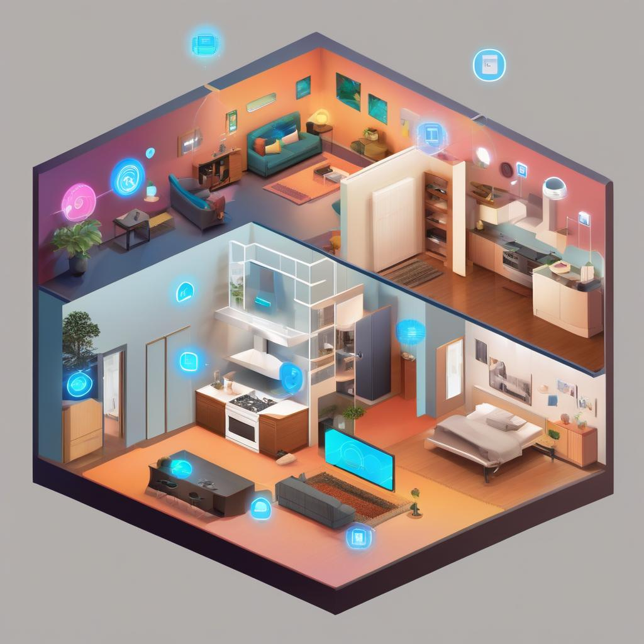
SLB Applications
Smart cars
Intelligent manufacturing
Smart terminals
Smart homes

Slide 5
Latency Definition
End-to-End
over-the-air transmission delay
User Plane (data link layer)
the one-way time it takes to successfully deliver an application layer packet/message from the radio protocol layer entry point to the radio protocol layer exit point via the radio interface in both UL/ DL directions
Control Plane (network layer)
the transition time from a most “battery efficient” state (e.g., idle state) to the start of continuous data transfer (e.g., active state)
queuing delay
processing/computing delay and retransmissions

Slide 6
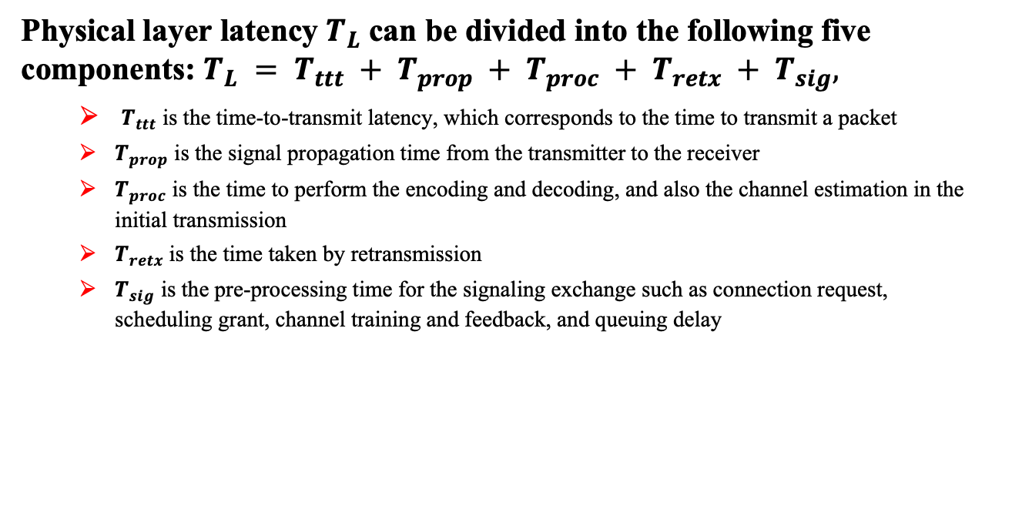
Physical Layer Latency
Physical layer latency $T_{L}$ can be divided into the following five components: $T_{L} = T_{ttt} + T_{prop} + T_{proc} + T_{retx} + T_{sig},$
$T_{ttt}$ is the time-to-transmit latency, which corresponds to the time to transmit a packet
$T_{prop}$ is the signal propagation time from the transmitter to the receiver
$T_{proc}$ is the time to perform the encoding and decoding, and also the channel estimation in the initial transmission
$T_{retx}$is the time taken by retransmission
$T_{sig}$ is the pre-processing time for the signaling exchange such as connection request, scheduling grant, channel training and feedback, and queuing delay

Slide 7



SLB Latency
Ultra-Low Latency (Air Interface) < 20.833μs
CP-OFDM waveform
Ultra-short frame structure and a flexible scheduling scheme of time domain resources

Slide 8
SLB Latency
Ultra-short frame structure
Overhead constrain frame length
Even worse in TDD scheme adopted by SBL
Frame structure length: 20.833μs
SLB designs a frame structure with 48 frames in one superframe equal to 1ms
Radio Frame #01
Radio Frame #02
Radio Frame #46
Radio Frame #47

Slide 9
SLB Latency
Flexible scheduling scheme of time-domain resource
Scheduling scheme of time-domain resources that corresponds to different sizes of packets.
Minimum scheduling units for small packets (1 frame, 20.833 ms) and large packets (6 frames, 125 ms)
The transmission period of large packets is a multiple of the minimum scheduling units, which can be equal to 6, 12, ., 48 frames.
Radio Frame #01
Radio Frame #02
Radio Frame #46
Radio Frame #47

Slide 10
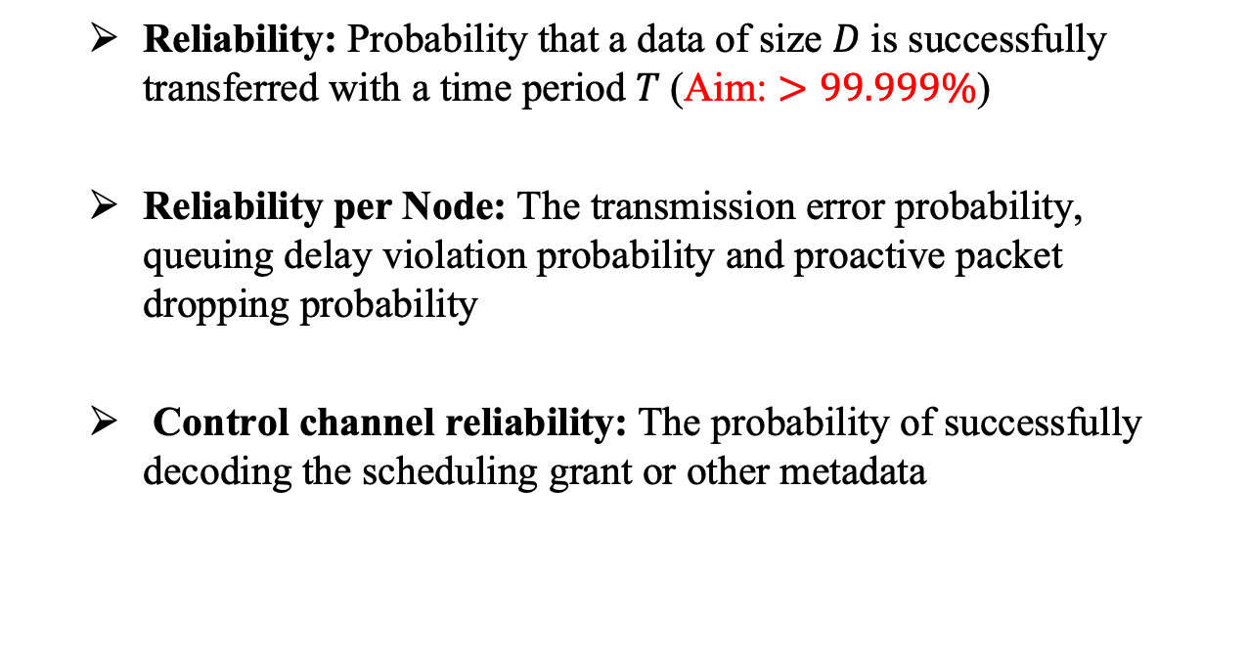
Reliability
Reliability: Probability that a data of size 𝐷 is successfully transferred with a time period 𝑇 (Aim: $>99.999\%$)
Reliability per Node: The transmission error probability, queuing delay violation probability and proactive packet dropping probability
Control channel reliability: The probability of successfully decoding the scheduling grant or other metadata
No packet drop
No packet delay
No erroneously decoding

Slide 11
SLB Reliability
Coding Scheme
Polar code to correct errors
capability for large code lengths
superb performance when correcting random errors
SLB adopts cyclic redundancy check (CRC)-assisted Polar codes with successive-cancellation list (SCL) decoders

Slide 12
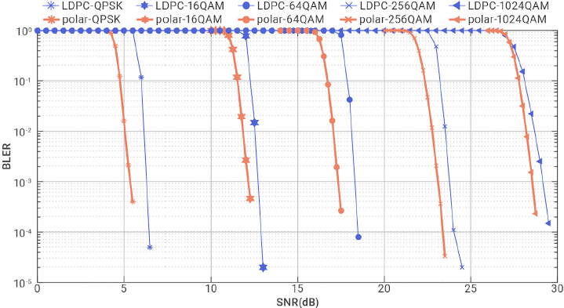
Reliability SLB vs WiFi 6 [1]

Slide 13
SLB Reliability
Retransmission
HARQ is deployed to improve the reliability while decreasing the number of retransmissions.
time variability of channels
multipath effect
other unpredictable interferences

Slide 14
Coupling Latency & Reliability
Under the constraints of a URLLC service, the definition of reliability should be coupled to the latency requirement
When latency requirement is absent (theoretically infinite) then transmitting at a rate that is lower than channel capacity offers perfect reliability
Definition for Reliability (application perspective): The probability that the latency does not exceed latency constraint (deadline)
Outage as the probability that it does

Slide 15
mmWave Impact on Latency & Reliability
Pros
High Bandwidth
higher data rates
High Capacity
more simultaneous connections to support dense deployments
Low Latency (Potential)
due to less signal dispersion

Slide 16
mmWave Impact on Latency & Reliability
Cons
High Path Loss and Penetration Loss
higher path loss and are severely attenuated by obstacles
impacts reliability.
Susceptibility to Blockage
Even minor obstructions can significantly impact signal strength, potentially leading to connection drops and impacting reliability
Increased Complexity
advanced beamforming techniques to overcome the inherent limitations of the frequency band
Rain Fade

Slide 17



SLB’s Rivalries & SLB Competitive Adv
WiFi –Only IEEE 802.11bd –MG V2X will support 60GHz band
Bluetooth
ZigBee
Latency & Reliability

Slide 18
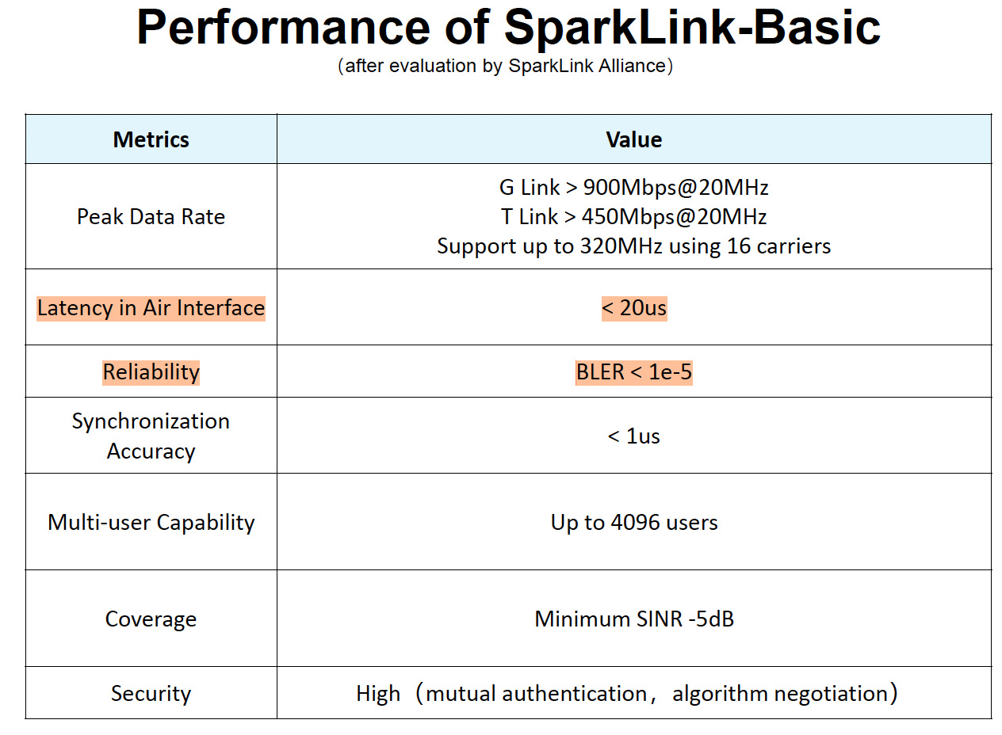
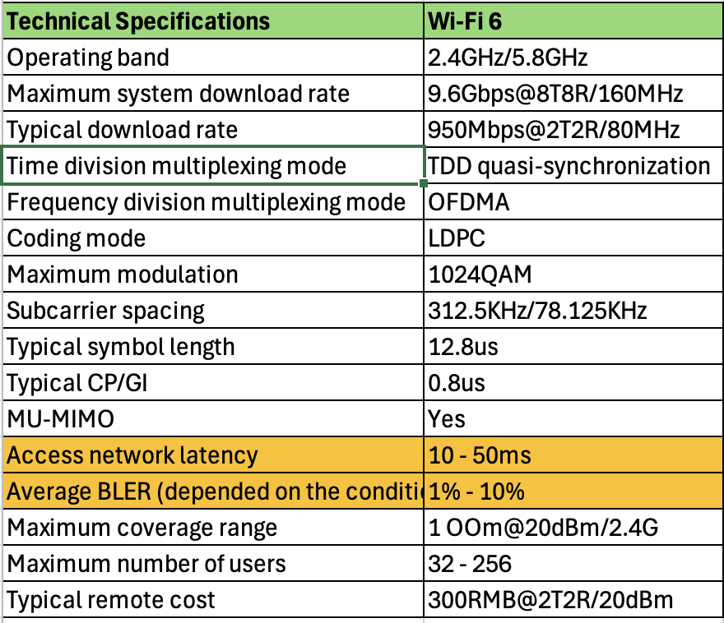
SLB’s vs WiFi 6 (IEEE 802.11ax)

Slide 19
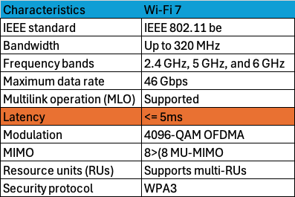
SLB’s vs WiFi 7 (IEEE 802.11be)

Slide 20
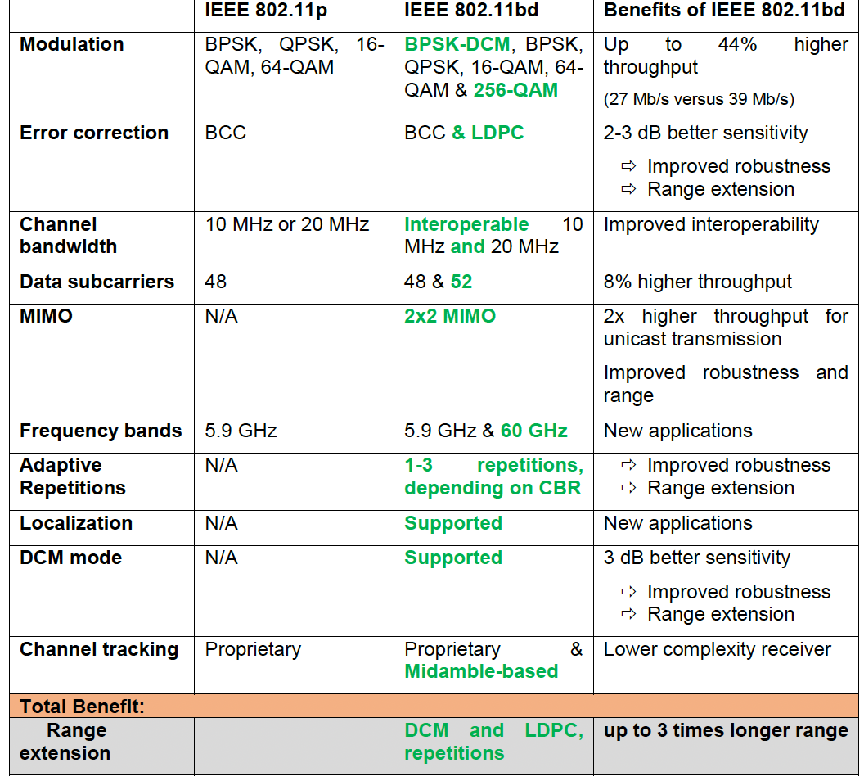
SLB’s vs (IEEE 802.11p & 802.11bd)
Latency for IEEE802.11p is 50ms
No latency is referred for IEEE802.11bd

Slide 21
Technical Challenges in mmWave
Limited research and measurements results.
Channel sounding is the use of directional beams which require fast beam switching under high mobility.
For the design of mmWave V2X radio access, it is necessary to characterize the mmWave radio propagation in V2X scenarios
Path loss
Shadowing
Blockage
Fast fading

Slide 22

mmWave for V2X Applications
ITU-R provided a guideline on the use of 57-66 GHz band for intelligent transport system (ITS) applications.
In Europe 63-64 GHz band is currently designated by CEPT/ECC.

Slide 23
Key Challenges for SLB on mmWave-Based V2X Applications
Initial Beam Alignment
Beam Tracking to maintain the mmWave link
Beam Recovery
Beam Management

Slide 24
Use Cases for SLB on mmWave-Based V2X Applications
Cooperative perception
High definition (HD) 3D map download
Sensor data upload
High-speed mobile broadband Internet access
Data rate: 10s to 100s of Mbps per application and so if we were to support multiple applications simultaneously, up to Gbps data rate is likely required.
Latency: 10 ms -100 ms is required for safety applications such as cooperative perception

Slide 25
My Contribution to the SparkLink over mmWave Bands Project (1)
Beam Alignment Latency: Time duration required for the completion of the beam alignment procedure
Beam alignment latency refers to the duration required to finalize the beam alignment procedure in V2X communication, commencing with the onset of a beam alignment request. This latency includes multiple stages, such as transmitting the request, obtaining the response, calculating beam angles, and modifying antenna directions.
Simulations will be conducted for:
Various number of antennas,
Path Loss, Fading, LoS/NLoS etc.

Slide 26
My Contribution to the SparkLink over mmWave Bands Project (2)
Alignment Probability: This metric serves as a crucial indicator of the system's reliability, reflecting the probability of the beam correctly matching with the receiver's beam within a defined tolerance.
Simulations will be conducted for:
Beam sweeping
Angle of arrival (AoA)/angle of direction (AoD) estimation
Side information beam alignment methods

Slide 27
My Contribution to the SparkLink over mmWave Bands Project (3)
Effective Achievable Rate: A fundamental parameter assessing the efficacy of data exchange following the alignment procedure.
Simulations will be conducted for:
Modulation techniques
Beamforming design,
Transmission diversity

Slide 28
References
[1] Gao M, Wan L, Shen R, Gao Y, Wang J, Li Y, Vucetic B. SparkLink: A short-range wireless communication protocol with ultra-low latency and ultra-high reliability. Innovation (Camb). 2023 Jan 31;4(2):100386.
[2] J. Tan et al., "Beam Alignment in mmWave V2X Communications: A Survey," in IEEE Communications Surveys & Tutorials, vol. 26, no. 3, pp. 1676-1709, thirdquarter 2024.
[3] T. Shimizu, V. Va, G. Bansal and R. W. Heath, "Millimeter Wave V2X Communications: Use Cases and Design Considerations of Beam Management," 2018 Asia-Pacific Microwave Conference (APMC), Kyoto, Japan, 2018, pp. 183-185
[4] CEPT/ECC, Harmonised use of the 63.72-65.88 GHz frequency band for Intelligent Transport Systems (ITS) https://docdb.cept.org/download/1563
[5] M. Giordani, A. Zanella, T. Higuchi, O. Altintas and M. Zorzi, "On the Feasibility of Integrating mmWave and IEEE 802.11p for V2V Communications," 2018 IEEE 88th Vehicular Technology Conference (VTC-Fall), Chicago, IL, USA, 2018, pp. 1-7
[6] R. I. Abd and K. S. Kim, "Protocol Solutions for IEEE 802.11bd by Enhancing IEEE 802.11ad to Address Common Technical Challenges Associated With mmWave-Based V2X," in IEEE Access, vol. 10, pp. 100646-100664, 2022

Slide 29
References
[7] Y. Cao, X. He, C. Yu and C. Yin, "Reliability and Latency of MmWave Communications Based on Blockage Avoidance in Internet of Vehicles," 2021 13th International Conference on Wireless Communications and Signal Processing (WCSP), Changsha, China, 2021, pp. 1-5
[8] CAR 2 CAR Communication Consortium. “Next Generation V2X –IEEE 802.11bd as fully backward compatible evolution of IEEE 802.11p,” February 2023. [https://www.car-2-car.org/documents/general-documents ]
[9] P. Popovski et al., "Wireless Access in Ultra-Reliable Low-Latency Communication (URLLC)," in IEEE Transactions on Communications, vol. 67, no. 8, pp. 5783-5801, Aug. 2019

